Slide 1
השיעור יתחיל ב- 12:15

Slide 2
Introduction to Python for Social Sciences
Iftach Amir, PhD

Slide 3
Basic Information
Course name: Introduction to Python for Social Sciences
Time: Sunday, 1215 - 1545
Instructor: Iftach Amir
Email: iftach.amir@gmail.com
Consult. hours: Flexible, arrange through mail

Slide 4
Goals:
Familiarity with Python

Slide 5
Goals:
Learn basic concepts in programming
Develop skills to (continue) learning by yourself from on-line resources and examples
Develop confidence to continue working with Python for *your* specific research needs.

Slide 6

Why should I learn Python (as a researcher)?
(or why is my department making me learn this?)

Slide 7
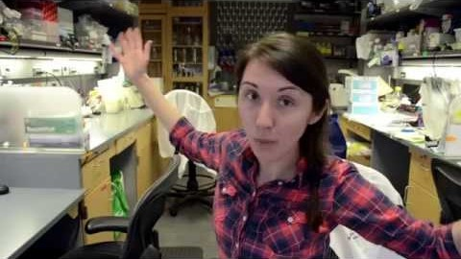

Slide 8
“The difficult part of learning to program lies with the fundamentals … once a researcher has those nailed down, adapting to a new language is just a matter of syntax. … What matters most in the early stages is having a good support network. … Pick the programming language based on what people around you are using, Increasingly, that language is Python.”
(link)

Slide 9
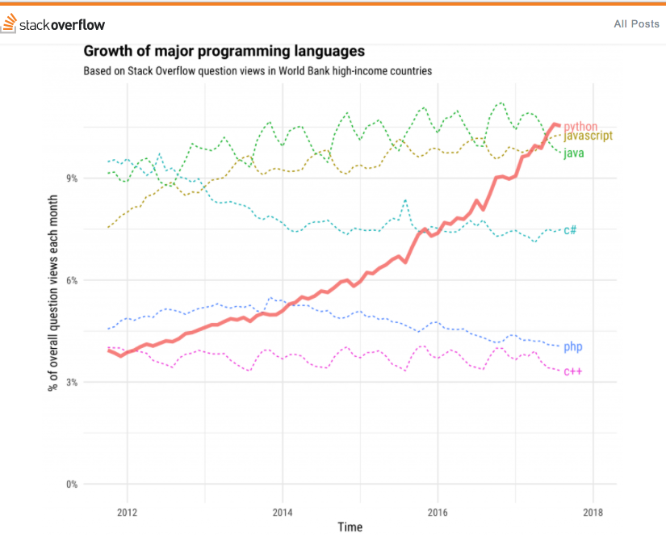
Also - TIOBE Index

Slide 10
Course requirements:
Attend and participate.
Complete readings and assignments before class.
End of course project.

Slide 11
Let’s get started

Slide 12
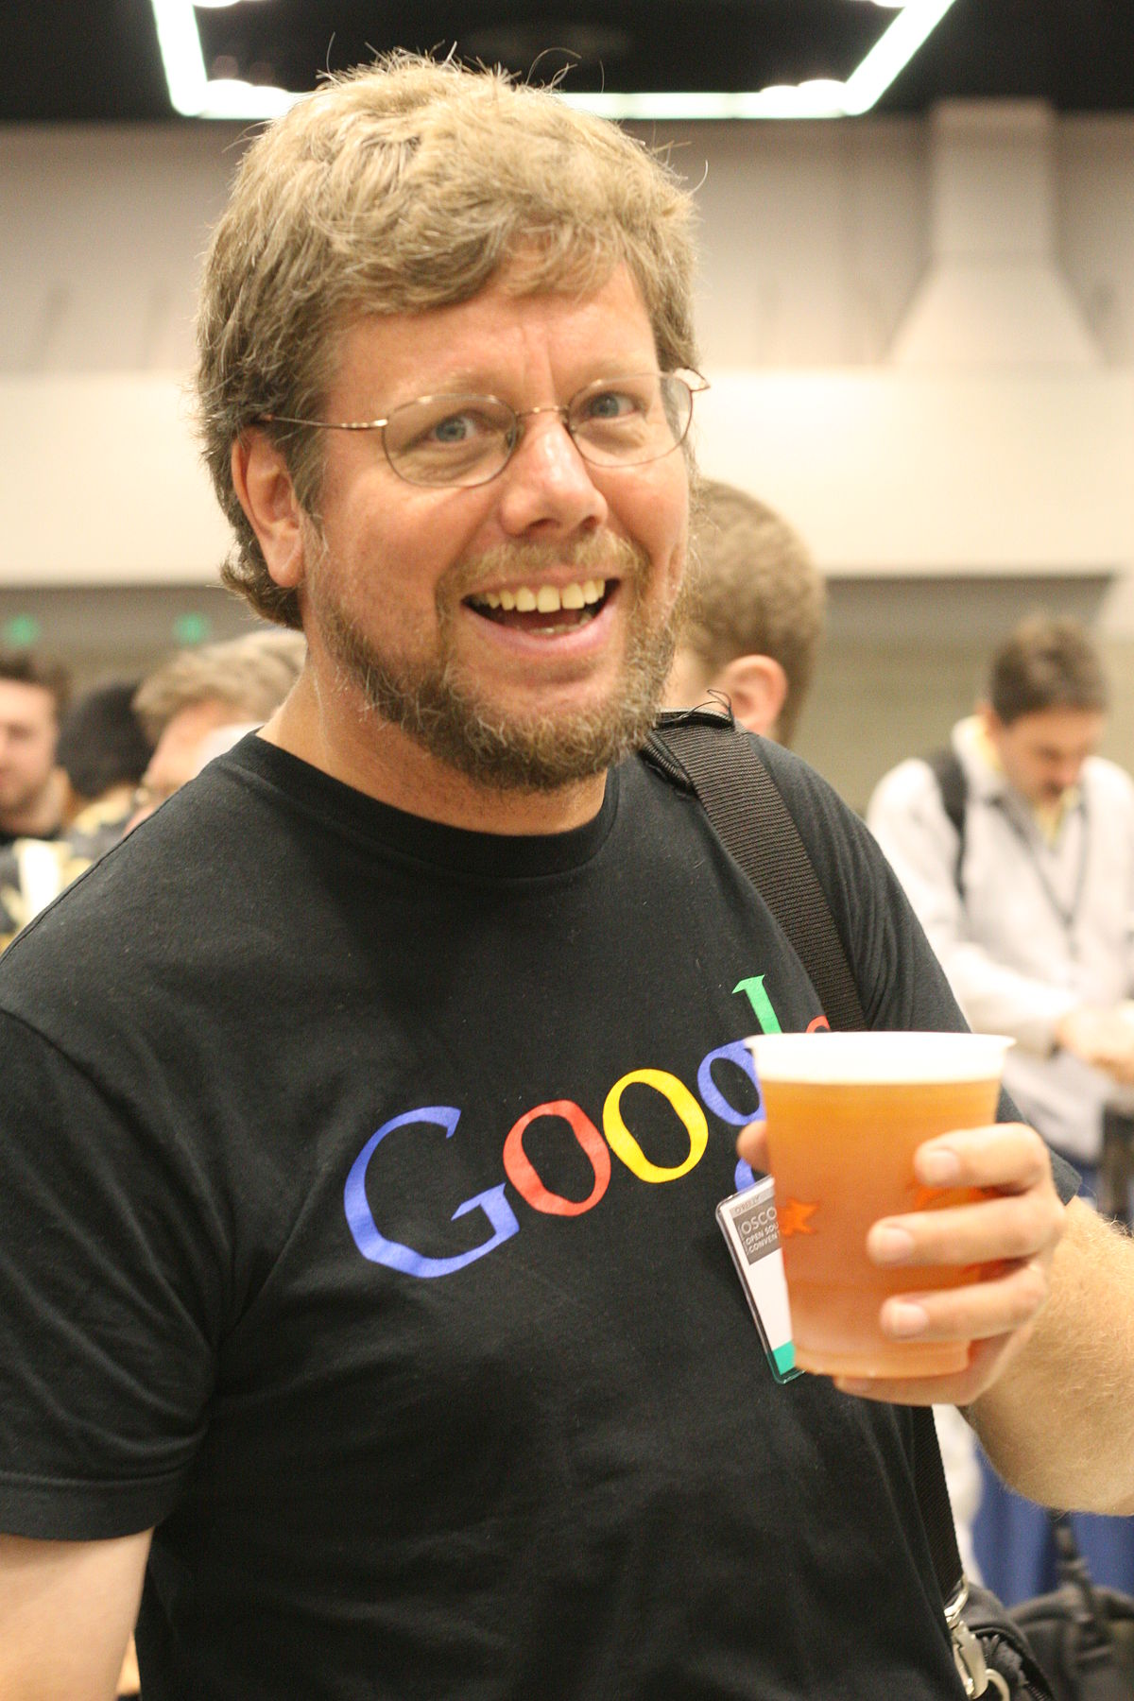

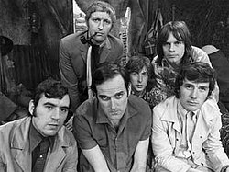

Slide 13

Video #1

Slide 14
print()

Slide 15
print()
print(“Hello world”)
parentheses
(function input)
function name

Slide 16
print()
print(“Hello world”)
Syntax errors
Runtime errors

Slide 17
print()
print(5)
print(5+5)

Slide 18
Operators
A symbol that performs an operation on two inputs / variables, e.g.:
+
-
=

Slide 19
Basic math operations
also here

Slide 20
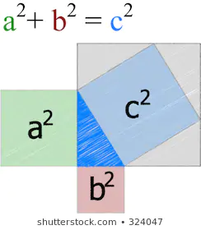
Variables and Assignments
What is a variable?
What is an assignment?
What is a valid variable name?

Slide 21
Variables and Assignments
What is a variable?

Slide 22
Variables and Assignments
What is an assignment?
X = 4
X ← 4

Slide 23
Variables and Assignments
What is a valid variable name?
Can’t start with a number
Can’t be a keyword ‘reserved’ for Python, e.g.:
return
global
Remember to give it a short, meaningful name
Use “_” character if you want to use more than one word
Variable names are case sensitive (small / capital letters)

Slide 24
Keep your code readable
Give your variables descriptive names (better than short names)
Use “ _ “ to separate words in variable name

Slide 25
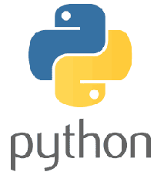
Variables and Assignments
Multiple assignment:
variable1, variable2 = value1, value2
x, y, z = 1, 2, 3

Slide 26
Fundamental variable types
Strings
Integer (number)
Float (number)
Boolean (True/False)
* duck typing

Slide 27
Variable types
Strings → str()
Integer (number) → int()
Float (number) → float()

Slide 28
type()
print()
input()
int()

Slide 29
x = int(input())
what’s going on here???

Slide 30

Before you continue to some exercises...
The importance of documenting your code

Slide 31

Conventions for writing Python code - PEP8

